Slide 1
Chap 5: Pointers and Arrays
Lecture1: Pointers and 1D array

Slide 2

Introduction
Program = Algorithm + Data structure
Subsequent, selection and loop blocks of statements.
Function: a group of statements achieves a specific task.
Nikiklaus Wirth
Notes:
凭借一句话获得1984图灵奖的Pascal之父——Nicklaus Wirth，让他获得图灵奖的这句话就是他提出的著名公式：“算法+数据结构=程序”。
这个公式对计算机科学的影响程度足以类似物理学中爱因斯坦的“E=MC^2”——一个公式展示出了程序的本质。

Slide 3
Introduction
Program = Data structure +Algorithm
Data structure
Data Types
Derived
Types
Fundamental
Types
User-defined
Types
Arrays
Pointers
Integral Types
Float / double
Character Types
Structures
Unions
Enumerations

Slide 4

Introduction
An array is a fixed-size sequenced collection of elements of the same data type.
Examples:
float height[50];
int number[5];
double scores[STU_NUM]; /*#define STU_NUM 60*/
int n = 100;
char string[ n ];

Slide 5
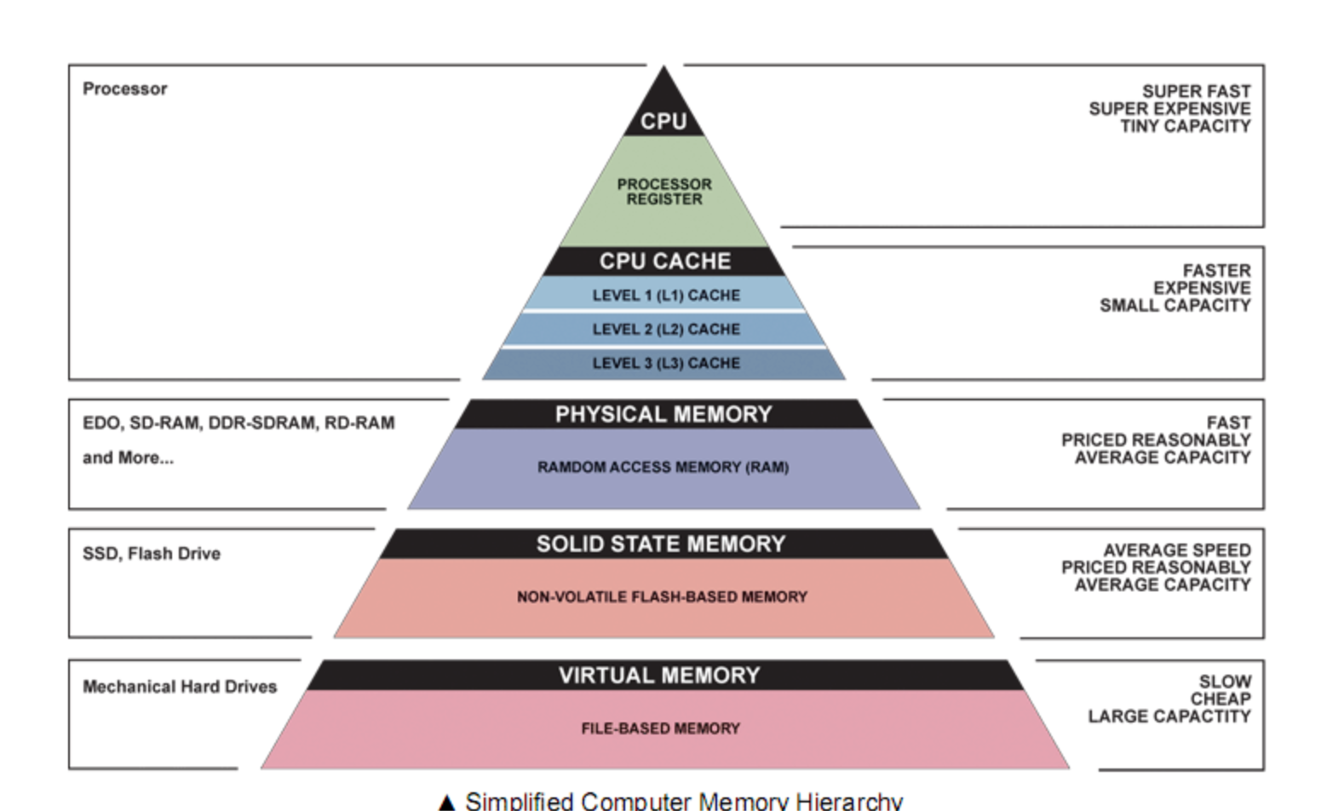
Introduction
A pointer is nothing but a variable that holds (contains)
an address, which is a location of an object in memory.

Slide 6
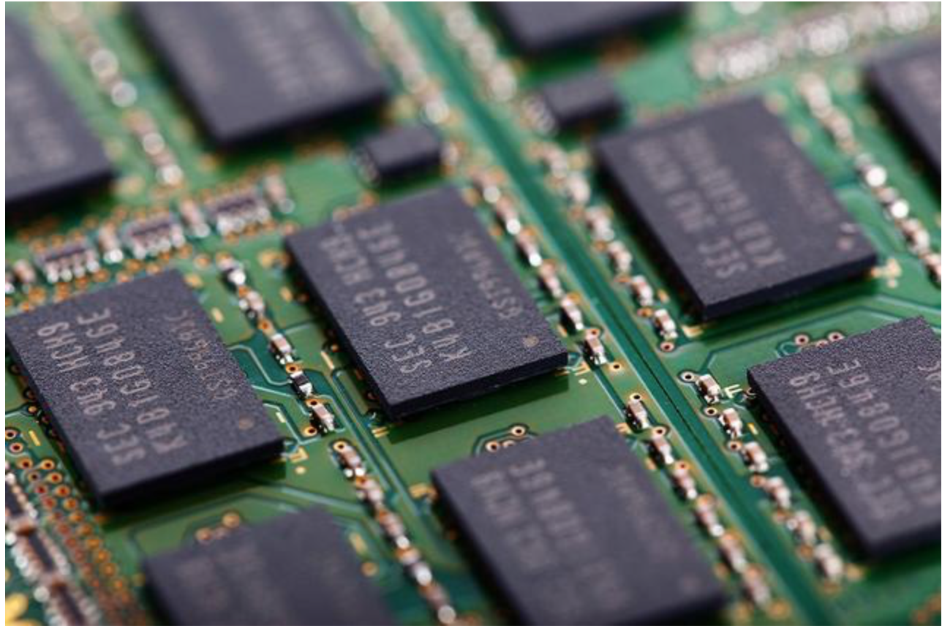
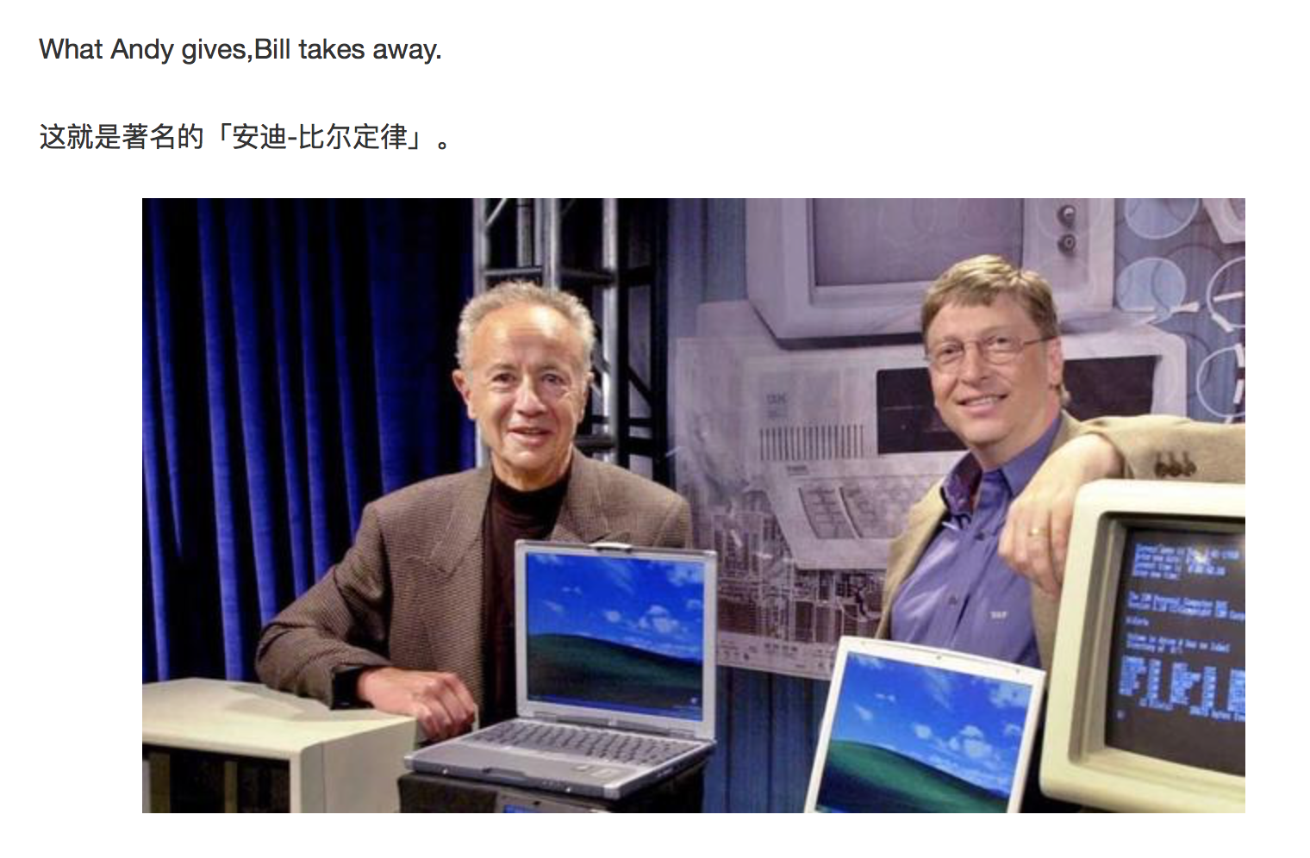
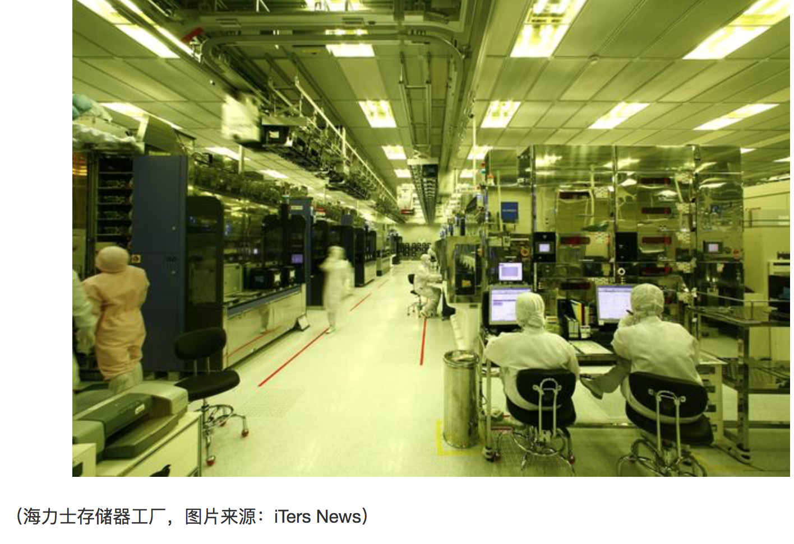
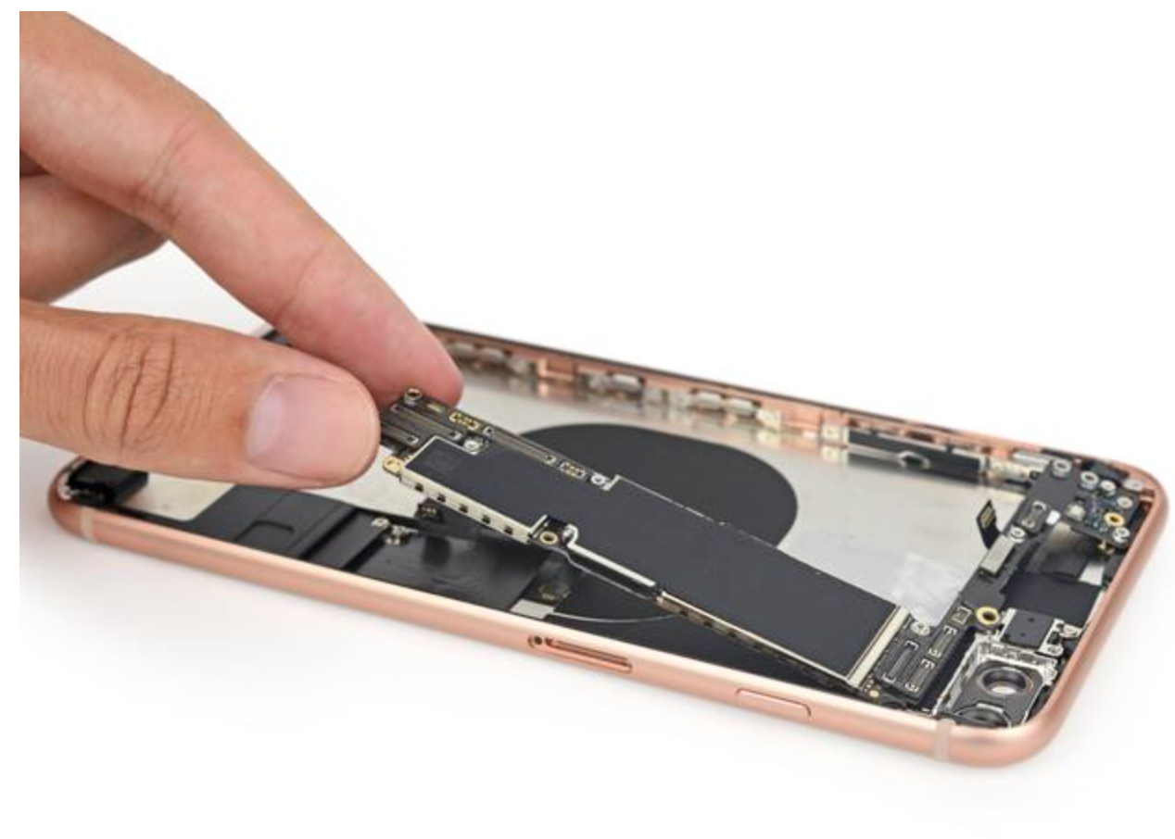
Notes:
安迪-比尔定理 （Andy and Bill’s Law）
IT产业中软件和硬件升级换代关系的一个概括。安迪指英特尔前CEO Andy Grove，比尔指微软前任CEO比尔·盖茨，这句话的意思是，硬件提高的性能，很快被软件消耗掉了。

Slide 7
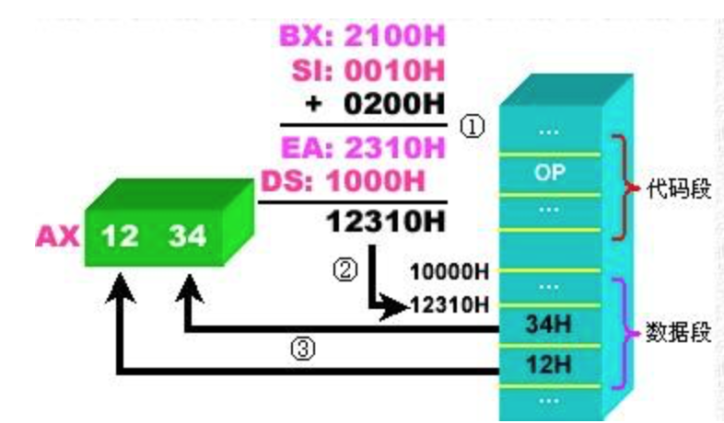
Introduction
A pointer is nothing but a variable that holds (contains)
an address, which is a location of an object in memory.
Pointers are one of the most distinct and exciting features of C language.
Pointers are a powerful tool that adds flexibility and efficiency to
the language although they appear a little confusing and difficult to
understand for beginners.

Slide 8
Understanding pointers
char str[3] 0X0066FDEF
int * pt 0X0066FDD0
int a 0X0066FDF4
Notes:
内存的概念
内部存储器( Memeory )是由存储单元组成的。它的特点是存储单元是线性连续的。
存储单元的最小单位是字节Byte。
地址的概念
为了访问内存中的某个存储单元要为它编号，这种编号称为内存地址Address。
通过地址就能够访问该地址所标识的存储单元

Slide 9
Understanding pointers
int quantity = 1024;
Find a location for the integer variable, with the name quantity and puts the value 1024 in that location.
A computer identifies locations by their addresses.
Each byte has a unique address represented by an integer.
We may assign this integer to a variable and use it.
This variable is called a ‘pointer’, which points other object.
Memory Cell (byte)
0
1024
1
.
1
.
2³²-1

Slide 10
Pointer declaration and initialization
pt_name points to a variable of type data_type
General form
data_type *pt_name;
Example:
int *p = &quantity;
pt_name needs a memory location
The * tells that the variable is a pointer variable
0
quantity
1024
1
.
p
1
.
2³²-1

Slide 11
Access the address of a variable
The & operator can be used only with a variable or an object with accessible memory.
int x[10]; p = &x[0]; p = &x[1];
125(pointing at constants) NO
int x[10]; &x (pointing at array names) NO
&(x+y)(pointing at expressions) NO
Every pointer points to a specific data type.
char name[10], * pt = name;
int a = 3; float *p = &a; NO(?)

Slide 12
Dereferencing operator
The unary operator * accesses the object to which the pointer points.
General form: precede to a pointer variable
*pointer_name
If a pointer points to the valid address of a variable, *pointer_name can be used in any context where the variable could (can be used as a variable name).
Can *pointer_name be a l-value?
Pay attention to the difference between the declaration of a pointer and dereference operator
int a = 3, *p;
p = &a;
printf(“%d”, *p);

Slide 13
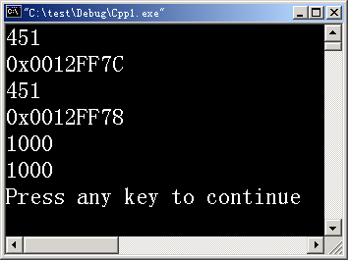
Dereferencing operator
int a = 451, b =1000 ;
printf(“%d\n”, a);
printf(“%x\n”, &a);
printf(“%d\n”, *(&a) );
int *iPtr = &b ;
printf(“%p\n”, ? );
printf(“%d\n”, ? );
printf(“%d\n”, ? );
iPtr, &b,
*iPtr, b,
*&iPtr, &*iPtr
*&b, &*b
2019/11/14

Slide 14
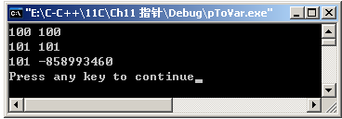
Dereferencing operator
p
num
int *p = 0, num = 1;
p = &num;
*p = 100;
printf(“%d %d\n”, num ,*p );
(*p) ++;
printf(“%d %d\n”, num ,*p );
num = *p --;
printf(“%d %d\n”, num ,*p );
&num
100
num++;
*(p--)
num = *p; p-- ;
2019/11/14

Slide 15
An example to illustrate pointers
#include <stdio.h>
#define NULL 0
int main()
{
int i1=3,i2=4;
int *p1,*p2,*p = NULL ;
p1=&i1; p2=&i2;
/*Swap the values of pointer variables*/
p=p1; p1=p2; p2=p3;
printf("i1=%d\ni2=%d\n",i1,i2);
printf("*pi1=%d\n*pi2=%d\n",*p1,*p2);
printf(“ pi1=%d\n pi2=%d\n”, p1,p2);
return 0;
}
* p2
p1
* p1
* p
&i2
10
i1
&i1
p
&i1
* p2
p2
* p1
&i2
20
i2
&i1

Slide 16
Figure demonstration
int i1=3,i2=4;
int *p1,*p2,*p;
p1=&i1 ; p2=&i2; p = 0;
p=pi1; p1=p2; p2=p;
int i1=3,i2=4;
int *p1=&i1,*p2=&i2,*p = 0;
*p=*p1; *p1= *p2; *p2= *p;

Slide 17
Pointer dereferencing in swap
#include <stdio.h>
int main()
{
int i1=3,i2=4;
int *pi1,*pi2;
int iTemp=0;
pi1=&i1; pi2=&i2;
/*Swap the values of variables*/
iTemp=*p1;
*p1=*p2;
*p2=iTemp;
printf("i1=%d\ni2=%d\n",i1,i2);
printf("*pi1=%d\n*pi2=%d\n",*pi1,*pi2);
return 0;
}

Slide 18
Pointers as function arguments
Values of actual parameters are passed to actual parameter when calling functions (passing by values)
The addresses of actual parameters are passed to a function as an argument passed by address.
( which can be implemented by passing pointers)

Slide 19
Swap the values of two variables
void main()
{
int iA=3,iB=4;
/function declaration*/
void swap(int iA1,int iB1);
/*function call*/
swap( iA, iB );
printf("iA=%d,iB=%d\n",iA,iB);
}
void swap( int iA1,int iB1 )
/*function definition*/
{ int iC1;
iC1=iA1;
iA1=iB1;
iB1=iC1;
}
Memory space
for main
Memory space for swap
iA1
4
3
iA
3
3
iC1
iB1
4
iB
4
3

Slide 20
Pointers as function arguments
int main()
{
int i1=3,i2=4;
int *pi1=&i1,*pi2=&i2;
swap( pi1,pi2 );
printf("i1=%d\ni2=%d\n",i1,i2);
printf(”p1=%d\np2=%d\n”,pi1,pi2);
printf("i1=%d\ni2=%d\n”,*pi1,*pi2);
return 0;
}
void swap(int *p1, int *p2 )
{ int *p ;
p=p1;
p2=p2;
p2=p;
}

Slide 21
Pointers as function arguments
int main()
{
int i1=3,i2=4;
int *pi1=&i1,*pi2=&i2;
swap( pi1,pi2 );
printf("i1=%d\ni2=%d\n",i1,i2);
printf(”p1=%d\np2=%d\n”,pi1,pi2);
printf("i1=%d\ni2=%d\n”,*pi1,*pi2);
return 0;
}
void swap(int *p1, int *p2 )
{ int *p ;
p=p1;
p2=p2;
p2=p;
}

Slide 22
Exercise
int main()
{
int a[ ] = {1,5,2,3,4,5,1};
int max ( int b[], int n);
int max = max(a, sizeof(a) );
}
Define a funciton to find the max element and print the positions in the array in main function.

Slide 23
Array
Declaration (definition) of an array
type array_name[array_size];
Examples:
int Number[3];
float fl[STU]; /*#define STU 3*/
double mat[size];/*int size = 3;*/
Any name that follows the rules for an identifier.
One fundamental, derived or user-defined data type
Integal expression
Number[0]
Number[1]
Number[2]
Number

Slide 24
Array initialization
General form
Initialized by a list having SIZE constants:
int a [ 5 ] = { 1, 3, 5, 7, 9 };
Initialized by a shorter list:
int b1 [ 5 ] = { 0 } ; int b2 [ 5 ] = { 1, 2, 3 } ;
Omit the size of array:
int c [] = { 1, 2, 3, 4, 5, 6 } ;
type array_name[SIZE]={val_1, val2, …, val_SIZE};

Slide 25
Array initialization
General form
Wrong initializations:
int d [ 5 ] = { 1, 2, 3, 4, 5, 6, 7 } ; / * Initialized by a longer list.*/
int a [ 5 ] = { 1, 3, , 7, 9 }; /* Skip elements*/
int b [ 5 ] = { } ; / *initialized by an empty list*/
float f [ 3 ] ; f = {1.1, 2.2, 3,3 } ;
type array_name[SIZE]={val_1, val2, …, val_SIZE};

Slide 26
Access array elements
General form by using subscripts:
array_name[integer_expression];
Notes:
The value of integer_expression should be within the bound [0,N-1]
Can be used in any context where a variable could.
Access the values one by one.
Operations on the whole are not defined;
int b[3], c[2]; b = c;
int a[N]
......
a [ 0 ]
a [ 1 ]
a [ 2 ]
a [ 3 ]
a [ 4 ]
a [ 5 ]
a [ 6 ]
a [ 7 ]
a [ 8 ]
a [ 9 ]
a[i] = j
a[ a[j] ]
......

Slide 27
Find any errors?
int a[10] = {1}, b[10], i ;
for ( i=0; i<10; i++)
{
a［i］= b[ i ] ;
printf("%d ″，a［i］);
}
for( i=10; i>0; i--)
printf("%d ″，a［i］);
Print garbage values
Print values ?

Slide 28
Access array elements
General form by using subscripts:
array_name[integer_expression];
Accessing operations
Find the initial address of an array by the array name.
Offset to the position specified by integer_expression- index
Read the value on the position.
a[index] * (a+index)
......
a
a [ 0 ]
a [ 1 ]
a [ 2 ]
a [ 3 ]
a [ 4 ]
a [ 5 ]
a [ 6 ]
a [ 7 ]
a [ 8 ]
a [ 9 ]
a +index
a [index]
......

Slide 29
Exercise
Insert an element to an ordered array to such a position that the expanded array is also an ordered one.
int iA[10]
1 | 3 | 5 | 8 | 9
int iValue
7
1 | 3 | 5 | 7 | 8 | 9

Slide 30
Algorithm
Insert a number into a sorted array
Find the position
Shift the elements afterwards
Assign the value to the position
int iValue
7
1 | 3 | 5
int iA[10]
8
9
7

Slide 31
Exercise
#include<stdio.h>
int main()
{ int iA[10]={1,3,5,6,9,10}; /*最初有序数组*/
int iNumber=6; /*最初有序数组数据个数*/
int i1, iIndex; /*插入位置*/
int iValue=7; /*插入值*/
/*Find the position*/
for(i1=0;i1<iNumber;i1++)
if(iA[i1]>iValue) break;
/*record the posistion */
iIndex=i1;

Slide 32
Exercise
/*Move elements */
for( i1=iNumber-1; i1>=iIndex; i1--)
iA[i1+1] = iA[i1];
/*insert elements */
iA[iIndex]=iValue;
/*print the new array*/
for(i1=0;i1<iNumber+1;i1++)
printf("%d\t",iA[i1]);
return 0;
}

Slide 33

Exercise
a
iA
/* insert a number into a sorted array
iA: target array;
iNumber: current number in the array;
iValue: value to be inserted*
return the position of the number in the array
/
int insert ( int iA[], int iNumber, int iValue) ;
int a[N] = {2,3,4}, n = 3, key = 2;
if( ? )
insert( a, n, key);
int* iA = a;
1
2
2
3
3
4

Slide 34
Program
void insert(int iA[], int iNumber, int iValue)
/* iA: target array; iNumber: current number in the array; iValue: value to be inserted*/
{
int i1, iIndex;
/*Find the position*/
for(i1=0;i1<iNumber && iA[i1] < iValue; i1++); /* Can use break */
/*Move elements */
iIndex=i1;
if (i1 < iNumber)
{
for(i1=iNumber-1; i1>=iIndex; i1--)
iA[i1+1]=iA[i1];
}
/*Insertion*/
iA[iIndex]=iValue;
}

Slide 35
Pointer and array
The array name is a constant giving the address of the initial element.
The constant can be assigned to a pointer, which is a variable holding the address.
int a[5]={1,2,3,4,5};
int *pi = a;
pi = &a[0];
a
......
0x0012F78
1
a [ 0 ]
a [ 1 ]
a [ 2 ]
a [ 3 ]
a [ 4 ]
0x0012F7C
2
0x0012F80
3
int b[5];
a=b;?
pi = b;?
0x0012F84
4
0x0012F88
5
......
0x0012F74
0x0012F78
pi

Slide 36
Precedence and associativity
Category
Operator
Associativity
Member
Unary
arithmetic
relational
bitwise
Logical
Conditional
Assignment
comma
() [] -> .
! ~ ++ -- + - * & (type) sizeof
* / % | + - |  | << >>
< <= > >= |  | == !=
& | ^ |  | ||
&& |  | ||
?:
= += -= *= /= %= &= ^= |= <<= >>=
,
L to R
R to L
L to R
L to R
L to R
L to R
R to L
R to L
L to R

Slide 37
Address/pointer arithmetic
Assignment of pointers of the same type except for a void type
Adding or subtracting a pointer and an integer
Typically used for a pointer to an array,
otherwise the behavior may be unpredictable.

Slide 38
Adding/subtracting a pointer
Adding/subtracting an integer n to a pointer means
obtain the address after/before n elements (objects) to which the pointer point.
a
......
0x0012F78
1
a [ 0 ]
a [ 1 ]
a [ 2 ]
a [ 3 ]
a [ 4 ]
int a[5]={1,2,3,4,5};
int *pi = a;
pi+3;
*(pi+3) ??
*(pi+3) == a[3]
0x0012F7C
2
0x0012F80
3
0x0012F84
4
0x0012F88
5
......
0x0012F74
0x0012F78
pi
*(p+3) /*offset of a pointer*/
p[3] /*index of a pointer*/
a[3] /*index of array name*/
*(a+3) /*offset of array name*/
Find the initial address of an array by the array name.
Offset to the position specified by the integer_expression.
Read the value on the position.

Slide 39
Summation program
#include <stdio.h>
#define ARR_NUM 5
void main()
{
int arr[ARR_NUM] = {1, 3, 5, 7, 9};
int i, sum;
int *p = arr;
for (i = 0, sum = 0; i < ARR_NUM; i++)
sum += arr[i];
sum += *(arr+i);
sum += p[i];
sum += *(p+i);
}

Slide 40
Address/pointer arithmetic
Assignment of pointers of the same type except for a void type
Adding or subtracting a pointer and an integer
Subtracting or comparing two pointers to members of the same array
Relational operators: comparing the address.
int a[N], *p1 , *p2 ;
p1 = a; p2 = a+N -1;
p1==a; p1<p2;
p2 – p1 = ?

Slide 41
Address/pointer arithmetic
Assignment of pointers of the same type except for a void type
Adding or subtracting a pointer and an integer
Subtracting or comparing two pointers to members of the same array
Relational operators: comparing the address.
Assigning or comparing to zero
A commonly used technique to test if a pointer is valid.
int *p = NULL, q = NULL;
…
if (p != NULL) *p = 1;

Slide 42
Excercise
What will this program print
int ref[10] = {8,4,0,2}, index, *ptr = ref;
for (index = 0; index < 4; index++, ptr++)
printf("%d%d%d%d\n", ref[index], *ptr, ref+index, ptr);
2. In question 1, how many elements does ref have?
3. In question 1, ref is the address of what?
What about ref+1? What does ++ref point to?

Slide 43
Pointer increment/decrement
Pointer increment/decrement means
move the pointer forward or backward one element.
The value of the pointer is changed before or after the movement(prefix and suffix)
a
......
0x0012F78
1
a [ 0 ]
a [ 1 ]
a [ 2 ]
a [ 3 ]
a [ 4 ]
int a[5]={1,2,3,4,5};
int *pi = a;
int b = *pi++; // *(pi++)
int c = *++pi;
int d = pi[0]++;//value increment
int e = (*pi)++;
*a++; ?
0x0012F7C
2
0x0012F80
3
4
5
0x0012F84
4
0x0012F88
5
......
0x0012F74
0x0012F7C
pi
0x0012F78
0x0012F80

Slide 44
Exercise
#include <stdio.h>
int main( )
{
int iArr[5],i;
int *pi=iArr;
for(i=0;i<5;i++)
*(pi+i)=i1;
for(i=0;i<5;i++)
printf("iArr[%d]=%d\n", i , *(iArr+i) );
return 0;
}
pi[ i ]《－》 iArr[i]
2019/11/14

Slide 45

Exercise
int iArr[5], i1, *pi=iArr;
for(i1=0;i1<5;i1++)
{ *pi = i1;
pi++;
}
pi = iArr;
for(i1=0;i1<5;i1++)
printf("iArr[%d]=%d\n", i1, *(pi++) );
pi = iArr
int iArr[5]
pi++
pi=iArr+1
2
4
3
6
1
pi =iArr+5
*
*
*
*
Logic error？
*
2019/11/14

Slide 46
Exercise
int iArr[5], i1=0， *pi = 0;
for( pi = iArr; pi<iArr+5 ;pi++,i1++)
*pi=i1;
pi=iArr;
for( ;pi<iArr+5; pi++)
printf(“ iArr[%d]=%d\n", i1 ,*pi);
pi = iArr
pi++
pi=iArr+1
2
4
3
6
1
pi =iArr+5
*
*
*
*
*
2019/11/14

Slide 47
Address/pointer arithmetic
Illegal operations
Assign a pointer of one type to a different type without casting
Add/subtract float or double values
Multiply/divide/shift/mask them
Add two pointers

Slide 48
Exercise
void inverse( float* a) ;
float a[4] ;
a[0] a[1] a[2] a[3] a[4]
pStart
pEnd
pStar
pEnd
float a[5];
a[0] a[1] a[2] a[3] a[4] a[5]
start
start
end
end

Slide 49
Exercise
void insert( int iA[], int iNumber, int iValue)
{
int i1, iIndex;
/*Find the position*/
for(i1=0;i1<iNumber && iA[i1] < iValue; i1++); /* Can use break */
/*Move elements */
iIndex=i1;
if (i1 < iNumber)
{
for(i1=iNumber-1; i1>=iIndex; i1--)
iA[i1+1]=iA[i1];
}
/*Insertion*/
iA[iIndex]=iValue;
}

Slide 50
C string
char str[5] = “Hi”;
char str[5] = {‘H’, ‘i’,’\0’};
char str[5] = {‘H’, ‘i’};
char str1[ ] = {‘H’, ‘i’};
char str2[ ] = {“Hi”};
char str3[5] = “Hi”;
sizeof ( str1 )== sizeof( str2) == sizeof( str3) ?
strlen( str1 )== strlen( str2) == strlen( str3) ?
str
‘H’
‘i’
‘\0’
0
0

Slide 51
C string
char cArr[11]=“C Language”;
char *pc = “Hello world!” ;
for( pc = cArr; pc<cArr+10; pc++)
printf("%c", *pc);
pc=cArr; /*指针复位*/
puts( pc);
putchar(‘\n’);
for(i=0; i<10; i++, pc++)
printf(“%s\n”, pc );
程序运行结果：
C Language
C Language
C Language
Language
Language
anguage
nguage
guage
uage
age
ge
e
C |  | L | a | n | g | u | a | g | e | \0

Slide 52
C string
Char array vs. char pointer-meaning
store/contain characters
access a string

Slide 53
Common mistakes
Write the ‘constant’ memory to which a pointer points.
char *src = “Hello”;
char des[50] = “Hello”;
*(src+2) = ‘L’;
*(des+2) = ‘L’;
printf(“%s”, src);
printf(“%s, des);
Memory for string constants
‘H’ | ‘e’ | ‘l’ | ‘l’ | ‘o’ | ‘\0’
Memory for string auto variables
src
0x0012F80
des
‘H’ | ‘e’ | ‘l’ | ‘l’ | ‘o’ | ‘\0’

Slide 54
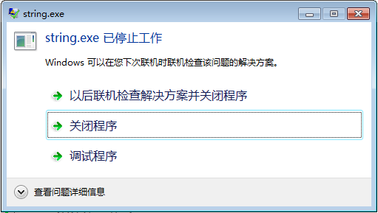
C string
Char array vs. char pointer- intialize/assigment
char *p＝″i love China！″；
char str［］＝“ i love China！″;
p＝″I love u！″；
str＝″I love you″；
*p = ‘I’;
str[0] = ‘I’;
scanf（″%s″，str）；
gets( p ); // p = str;
puts( p+=7);
puts( a+=7);

Slide 55
Exercise
Define a function to get the length of a string (ex3.c)
char str1[10], *pstr="输入：";
printf("%s\n",pstr);
gets(str1);
puts(str1);
int getLen( char* p);
int i = getLen(pstr);
int j = getLen(str1);

Slide 56
Comparing pointers
The difference (subtraction) between two pointers returns the offset in terms of elements (objects)
Relational operators on pointer: compares the address
int strlen(char *s)
{
char *p = s;
while (*p != ‘\0’) p++;
return (p-s);
}
&iArr[1]< &iArr[3]
pi<iArr+3 /* p = iArr;*/

Slide 57
Common mistakes
Use the incremented pointers
#include <stdio.h>
#define ARR_NUM 5
void main()
{
char *src = “Hello world\n”;
char des[ARR_NUM];
char *p = des;
while (*p++ = *src++);
printf(“The original string is %s”, src);
}
Why does it work when calling a function by the pointer as an actual argument?
strcpy(p, src);

Slide 58
Pointer demonstration
\0
void str_cpy(char *des, char *src)
{
int i = 0, len = strlen(src);
for (i = 0; i < len; i++)
{
des[i] = src[i];
}
}
void str_cpy(char *des, char *src)
{
int i = 0;
while (src[i] != ‘\0’);{
des[i] = src[i];
i++;
}
}
void str_cpy(char *des, char *src)
{
while (*des++ = *src++);
}

Slide 59
Arrays with variable length
C prohibits auto arrays with variable length
Use the library function malloc(N) to allocate sequenced memory blocks with N bytes. The function returns the initial address of the memory with void type.
How can we use the memory blocks as a normal array, e.g., arr[i], *(arr+i)?
{
int N=4;
/*intend to declare an array to store scores*/
float scores[N];
}

Slide 60
Declaration and usage
General form
Use the pointer as a pointer to an normal array
pi[i], *(pi+i)
*pi++ /*Restore pi to the original address before calling free
Release manually (your job) the memory to which the pointer points.
free(pNum); pNum = NULL; /* in case pNum being used later*/
data_type *pointer_name =
(data_type *) malloc( N*sizeof(data_type) )
Examples:
int *pNum = (int *)malloc(m * sizeof(int));
float *pScore = NULL;
pScore = (float *) malloc(n*sizeof(float));

Slide 61
Homework
Exercise 5-2 and 5-3.
Write a pointer version of functions atoi, itoa, and reverse in the textbook.

